Slide 1
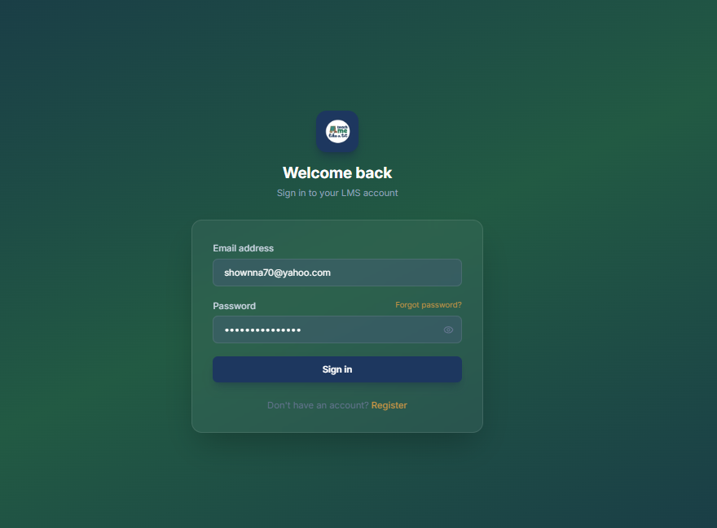

Log in Page
CURRENT
TARGET
1
2
5
3
3
5
5
5
1. Update logo
2. Background
3. Heading
4. Login card color
Decorative graphics
  Footer: Navy bottom curve (navy:1D375F / Gold #C9A55A)

